Slide 1
Retinal Vessel Analysis To Detect Hypertension And Predict Cardiovascular Diseases
AUTHORS :
Nikita Ravi
Omkar N Daivajna
Sakshi S Neelgund
Adithya R
Dr. Bharathi Malakareddy
Sowmya V L

Slide 2
AGENDA
Introduction
Motivation
Literature Survey
Novelty of Work
Problem Statement
Objectives
Proposed Methodology
Result
References

Slide 3
INTRODUCTION
Hypertension is a medical condition characterized by consistently elevated blood pressure in the arteries, potentially leading to serious health complications if left untreated.
Atherosclerosis is a condition characterized by the buildup of plaque in the arteries, narrowing and hardening them, often leading to reduced blood flow.
Stroke is a cardiovascular disease characterized by disrupted blood flow to the brain, leading to cell damage or death.
Retinal vessel analysis can help detect hypertension and predict cardiovascular diseases like stroke and atherosclerosis.

Slide 4
MOTIVATION
Discussion with Ophthalmologist: we met with an Ophthalmologist Dr. Nagabhusana , Akshaya Netralaya.
Early Detection Impact: to improve healthcare and positively impact patient outcomes by enabling early, non-invasive detection of diseases like hypertension and prediction of cardiovascular diseases like stroke and atherosclerosis.
Reducing Burden: to reduce the financial and emotional burdens on individuals and healthcare systems.
Health Equity: to ensuring that non-invasive healthcare screening is accessible to all, promoting fairness in healthcare access.

Slide 5
LITERATURE SURVEY
TITLE | SUMMARY | LIMITATIONS
1. Syed Nakib Hossain, Shamman Noor,et al.“Automated Hypertensive Retinopathy Detection from Fundus Retinal Images”(2020) | Automated Detection Method: Proposes a method to detect Hypertensive Retinopathy (HR) stages from fundus retinal images using Morphological Image Processing . Feature Extraction & Diagnosis: Utilizes contour detection and area thresholding to segment vessels and calculate the Arteriovenous Ratio (AVR) for HR diagnosis | Accuracy of segmentation can be increased with DNN. Better method of background removal method can be used before segmentation.
Notes:
The central retinal venular equivalent (CRVE) is a measurement of the diameter of retinal vessels. It's expressed along with the central retinal arteriolar equivalent (CRAE).
The ratio of arterial and venular caliber (AVR) is almost linear with blood pressure. The formula is AVR = CRAE / CRVE.

Slide 6
LITERATURE SURVEY(Contd..)
TITLE | SUMMARY | LIMITATIONS
2. Neubauer, Aljoscha S., et al. "Retinal vessel analysis reproducibility in assessing cardiovascular disease." Optometry and Vision Science 85.4 (2018) | Analysis was performed on retinal photographs taken by a retinal thickness analyzer Validation showed an excellent agreement between semiautomated software and manual vessel measurements There was no effect of age on AVR. Other risk factors such as diabetes, smoking, body mass index, and current blood pressure showed some trends on multifactorial analysis | Sample selection : Only dataset with patients over the age of 50 were considered. Static images were used without taking into account what changes might occur in the future.

Slide 7
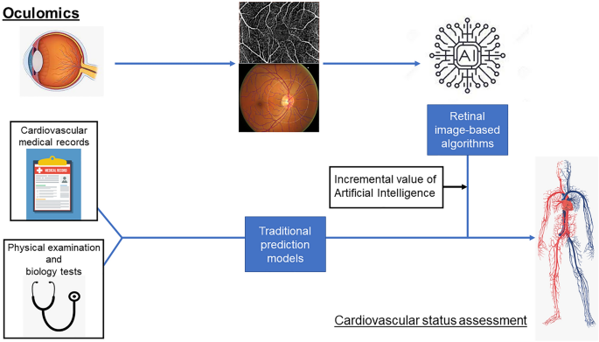
LITERATURE SURVEY(Contd..)
Fig 1. Cardiovascular status assessment

Slide 8
LITERATURE SURVEY (Contd..)
TITLE | SUMMARY | LIMITATIONS
3. Optic Disc and Exudates Segmentation on Retinal Fundus Images Using Mask R-CNN, IEEE Xplore, 2022 | The paper addresses optic disc and exudates segmentation in retinal fundus images via Mask R-CNN . By utilizing Mask R-CNN, known for its prowess in instance segmentation, the study achieves precise delineation of optic disc and exudates. | Focus on Intersection over Union (IoU): The paper relies solely on IoU for evaluation. While IoU is a common metric, it doesn't capture aspects like shape accuracy or localization errors. Lack of comparison with other methods: The paper doesn't explicitly compare its Mask R-CNN approach with other segmentation techniques on the same dataset.

Slide 9
LITERATURE SURVEY (Contd..)
TITLE | SUMMARY | LIMITATIONS
4] Poznyak, Anastasia V., et al. "Hypertension as a risk factor for atherosclerosis: Cardiovascular risk assessment." Frontiers in Cardiovascular Medicine 9 (2022). | The study conducted by Poznyak, Anastasia V., et al. examines hypertension role as a significant risk factor for atherosclerosis and subsequent cardiovascular diseases (CVDs), including cardiac events . It underscores the importance of understanding and managing hypertension to mitigate the risk of developing atherosclerosis and related cardiovascular complications. | Limited extensive studies on the impact of various blood pressure values on atherosclerosis development lead to gaps in understanding . The outcomes of experiments testing whether antihypertensive drugs affect the buildup of calcium in the coronary arteries and the occurrence of heart-related problems are uncertain.

Slide 10
NOVELTY OF WORK /
SOCIAL RELEVANCE
Early Disease Detection: Our model will be able to detect hypertension and exudates in its early stages and predict cardiovascular diseases like stroke and atherosclerosis.
Inclusivity: By making use of existing retinal image data, we ensure that healthcare screening is accessible to everyone, regardless of their background or location. This promotes a fair and inclusive approach to healthcare.
Preventative Healthcare: Our work encourages people to focus on preventing diseases rather than dealing with them after they've developed. This not only reduces the burden on individuals and society but also shifts our society towards being more health-conscious.

Slide 11
OBJECTIVES
To detect the class of hypertensive retinopathy.
To predict the presence of cardiovascular diseases like stroke.

Slide 12
PROBLEM STATEMENT
Retinal Vessel Analysis based detection of hypertension and prediction of cardiovascular diseases.

Slide 13
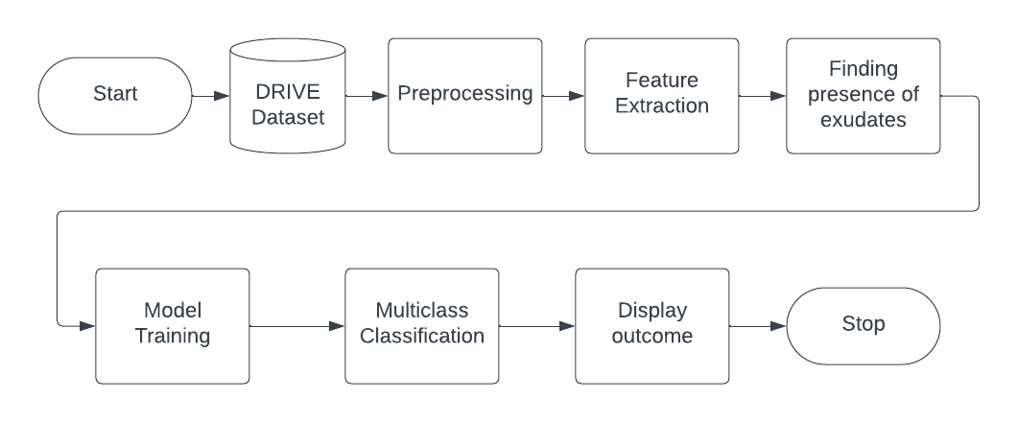
METHODOLOGY / BLOCK DIAGRAM
Fig. 2. Block Diagram of Proposed Methodology

Slide 14
METHODOLOGY / WORKING PRINCIPLE (Contd..)
.
.
Data Acquisition and Preprocessing: Utilize the publicly available DRIVE dataset for retinal image analysis.
Preprocess images by isolating the green channel, enhancing contrast using CLAHE, and applying morphological transformations for vessel segmentation.
Arteriovenous Ratio (AVR) Calculation: Segment retinal vessels and detect the optic disc to determine the Region of Interest (ROI).
Calculate AVR based on vessel width data, distinguishing between arterioles and venules.
Exudates Detection: Preprocess retinal images by extracting the green component and enhancing contrast
Employ edge detection filters and thresholding for blood vessel segmentation and apply morphological operations for refining segmentation and detecting exudates.
Notes:
Hypertensive retinopathy and AVR are linked:
Stage 1 -> AVR > 0.9
Stage 2 -> 0.8 < AVR < 0.9
Healthy -> 0.7 < AVR < 0.8
Stage 3 -> 0.7 > AVR > 0.5
Stage 4 -> AVR < 0.5

Slide 15
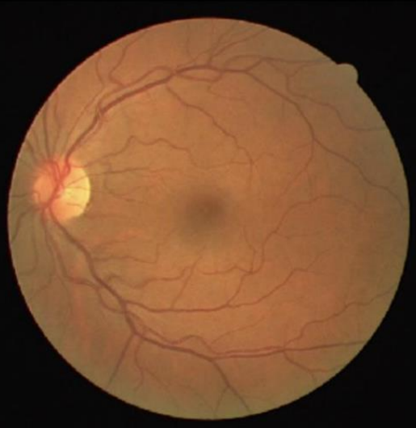
METHODOLOGY / WORKING PRINCIPLE (Contd..)
Fig 2. fundus retina from the DRIVE dataset

Slide 16
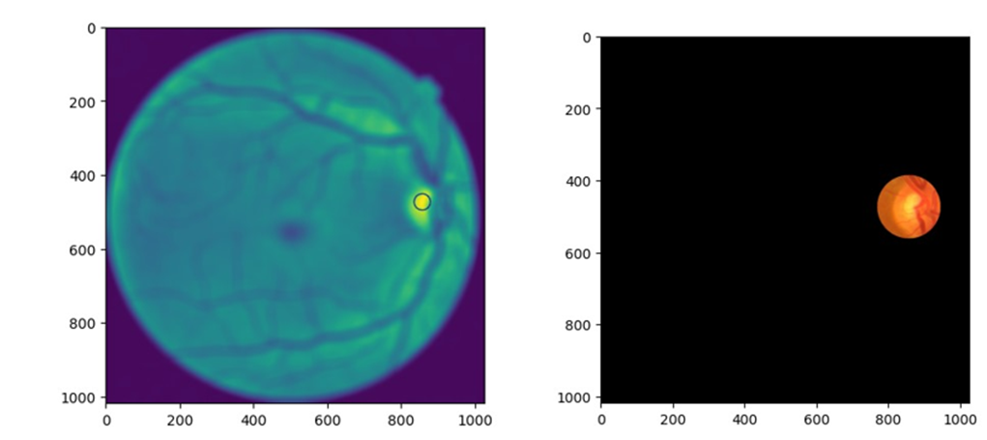
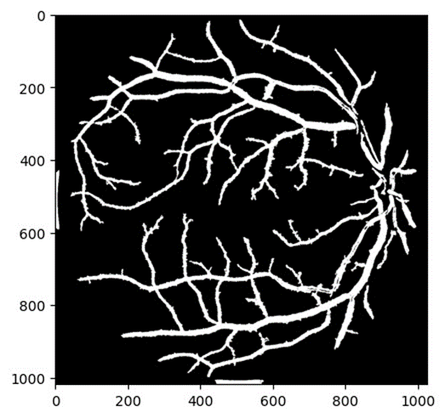
METHODOLOGY / WORKING PRINCIPLE (Contd..)
Fig 3(a). Retinal Image before detecting Region of Interest
Fig 3(b) .After detecting the Region of Interest (right)
Fig 4. Segmented Retinal Image of Region of Interest

Slide 17
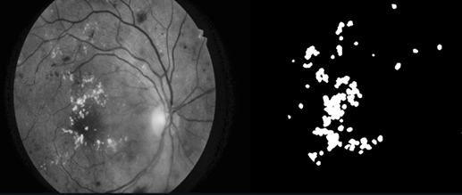
METHODOLOGY / WORKING PRINCIPLE (Contd..)
Fig. 5(a) Greyscale Retinal Image
Fig. 5(b) Presence of exudates

Slide 18
METHODOLOGY / WORKING PRINCIPLE (Contd..)
Features | Normal Ranges
CRVE | 20 - 30 mm
CRAE | 5 - 10 mm
AVR | 0.7 - 0.8
Exudates | Not Present
Table 1. Interpretation of Features

Slide 19
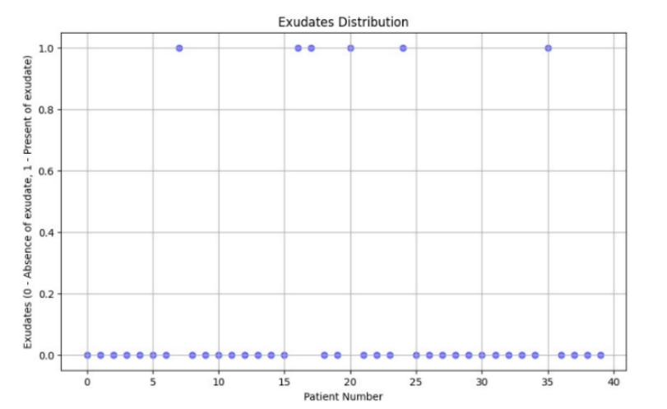
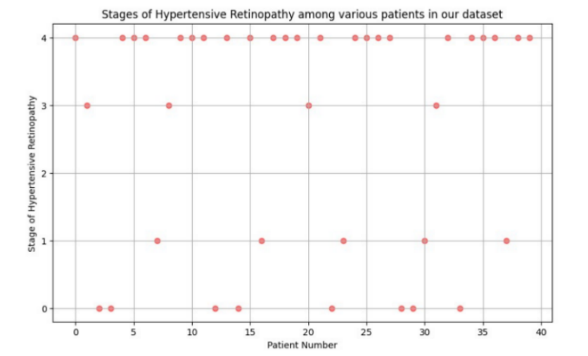
METHODOLOGY / WORKING PRINCIPLE (Contd..)
Distribution of Exudates Among Different Patients in Our Dataset
Stages of Hypertensive Retinopathy among various patients

Slide 20
METHODOLOGY / WORKING PRINCIPLE (Contd..)
Model Training and Classification: Classify hypertensive retinopathy into mild, moderate, and accelerated stages based on retinal features.
Train classification models (Logistic Regression, K-Nearest Neighbors, SVM, Decision Tree) on preprocessed data to predict retinopathy severity.
Evaluate model performance using metrics like accuracy, precision, and recall to identify the most suitable classifier.
Association Analysis with Stroke and CVDs: Analyze the relationship between hypertensive retinopathy features, such as AVR and exudates, with stroke and other cardiovascular diseases..
Provide insights into the ocular manifestations of hypertension and their implications for systemic health, aiding in proactive management strategies for individuals with hypertension.

Slide 21
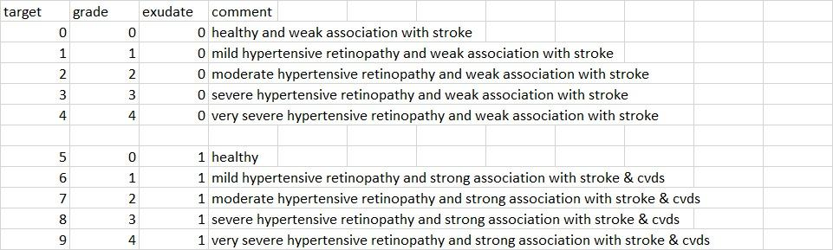
METHODOLOGY / WORKING PRINCIPLE (Contd..)
Table 2. Multiclass Classification based on Class of Hypertension and Presence of Exudates

Slide 22
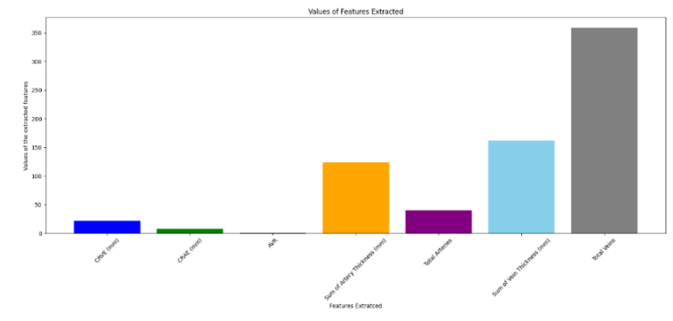
RESULTS
Fig 6. Patient-extracted feature values

Slide 23
RESULTS (Contd..)
Model | Accuracy | Precision | Recall | F1-score
Logistic Regression | 0.875 | 0.8125 | 0.875 | 0.838
K-Nearest Neighbors | 0.750 | 0.6667 | 0.750 | 0.6667
Support Vector Machine | 0.875 | 0.8125 | 0.875 | 0.838
Decision Tree | 0.875 | 0.8125 | 0.875 | 0.838
Table 3. Performance metrics of classification models

Slide 24
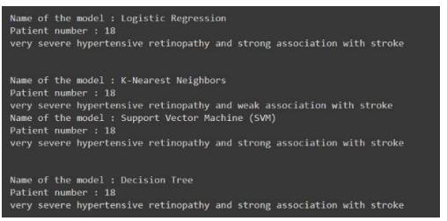
RESULTS (Contd..)
Fig. 7 Model’s Classification Results

Slide 25
REFERENCES
[1] Poznyak, Anastasia V., et al., F.: Hypertension as a risk factor for atherosclerosis: Cardiovascular risk assessment. Frontiers in Cardiovascular Medicine 9 (2022)
[2] Suri, Jasjit S., et al. "Deep learning paradigm for cardiovascular disease/stroke risk stratification in Parkinson’s disease affected by COVID-19: a narrative review." Diagnostics 12.7 (2022)
[3] Turana, Yuda, et al. "Hypertension and stroke in Asia: a comprehensive review from HOPE Asia." The Journal of Clinical Hypertension 23.3 (2021).
[4] Badawi, Sufian A., et al. "Detection and grading of hypertensive retinopathy using vessels tortuosity and arteriovenous ratio." Journal of Digital Imaging (2022).
[5] Tien Yin Wong, Rachel McIntosh, Hypertensive retinopathy signs as risk indicators of cardiovascular morbidity and mortality, British Medical Bulletin, Volume 73-74, Issue 1, 2005, Pages 57–70.
[6] Hanssen, Henner, Lukas Streese, and Walthard Vilser. "Retinal vessel diameters and function in cardiovascular risk and disease." Progress in retinal and eye research 91 (2022)
[7] Badawi, Sufian A et al. “Detection and Grading of Hypertensive Retinopathy Using Vessels Tortuosity and Arteriovenous Ratio.” Journal of digital imaging vol. 35,2 (2022)

Slide 26
REFERENCES
[8] Ding, Jie, et al. "Retinal vascular caliber and the development of hypertension: a meta analysis of individual participant data." Journal of hypertension 32.2 (2014)
[9] Chala, Mohamed, et al. "An automatic retinal vessel segmentation approach based on Convolutional Neural Networks." Expert Systems with Applications 184 (2021).
[10] Hossain, Syed Nakib, et al. "Automated Hypertensive Retinopathy Detection from Fundus Retinal Images." Department of Electrical and Electronic Engineering, Bangladesh University of Engineering and Technology, Dhaka-1205, Bangladesh. (2020)
[11] Guimarães, Juliana & Amorim, Luciana & Ferreira, Flávia & Peixoto, Zélia. (2019). Automatic segmentation of blood vessels in retinal images using 2D Gabor wavelet and sub-image thresholding resulting from image partition. Biomedical Engineering. 39.10.1007/s42600-019-00028-9.
[12] Y. Zong et al., "U-net Based Method for Automatic Hard Exudates Segmentation in Fundus Images Using Inception Module and Residual Connection," in IEEE Access, vol. 8, pp. 167225-167235, 2020, doi: 10.1109/ACCESS.2020.3023273.

Slide 27
REFERENCES
[13] A. Elbalaoui, M. Boutaounte, H. Faouzi, M. Fakir and A. Merbouha, "Segmentation and detection of diabetic retinopathy exudates," 2014 International Conference on Multimedia Computing and Systems (ICMCS), Marrakech, Morocco, 2014, pp. 171-178, doi: 10.1109/ICMCS.2014.6911368.
[14] Chen, Xuling, et al. "Hypertensive retinopathy and the risk of stroke among hypertensive adults in China." Investigative Ophthalmology & Visual Science 62.9 (2021)
[15] Krasińska, Aleksandra, Agata Brązert, and Jarosław Kocięcki. "The history of research of the ophthalmic aspects of hypertension." Medical Journal of Cell Biology 9.1(2021)
[16] Liew G, Wang JJ, Mitchell P, Wong TY. Retinal vascular imaging: “a new tool in microvascular disease research.” Circ Cardiovasc Imaging, 2023.

Slide 28
THANK YOU

